Slide 1
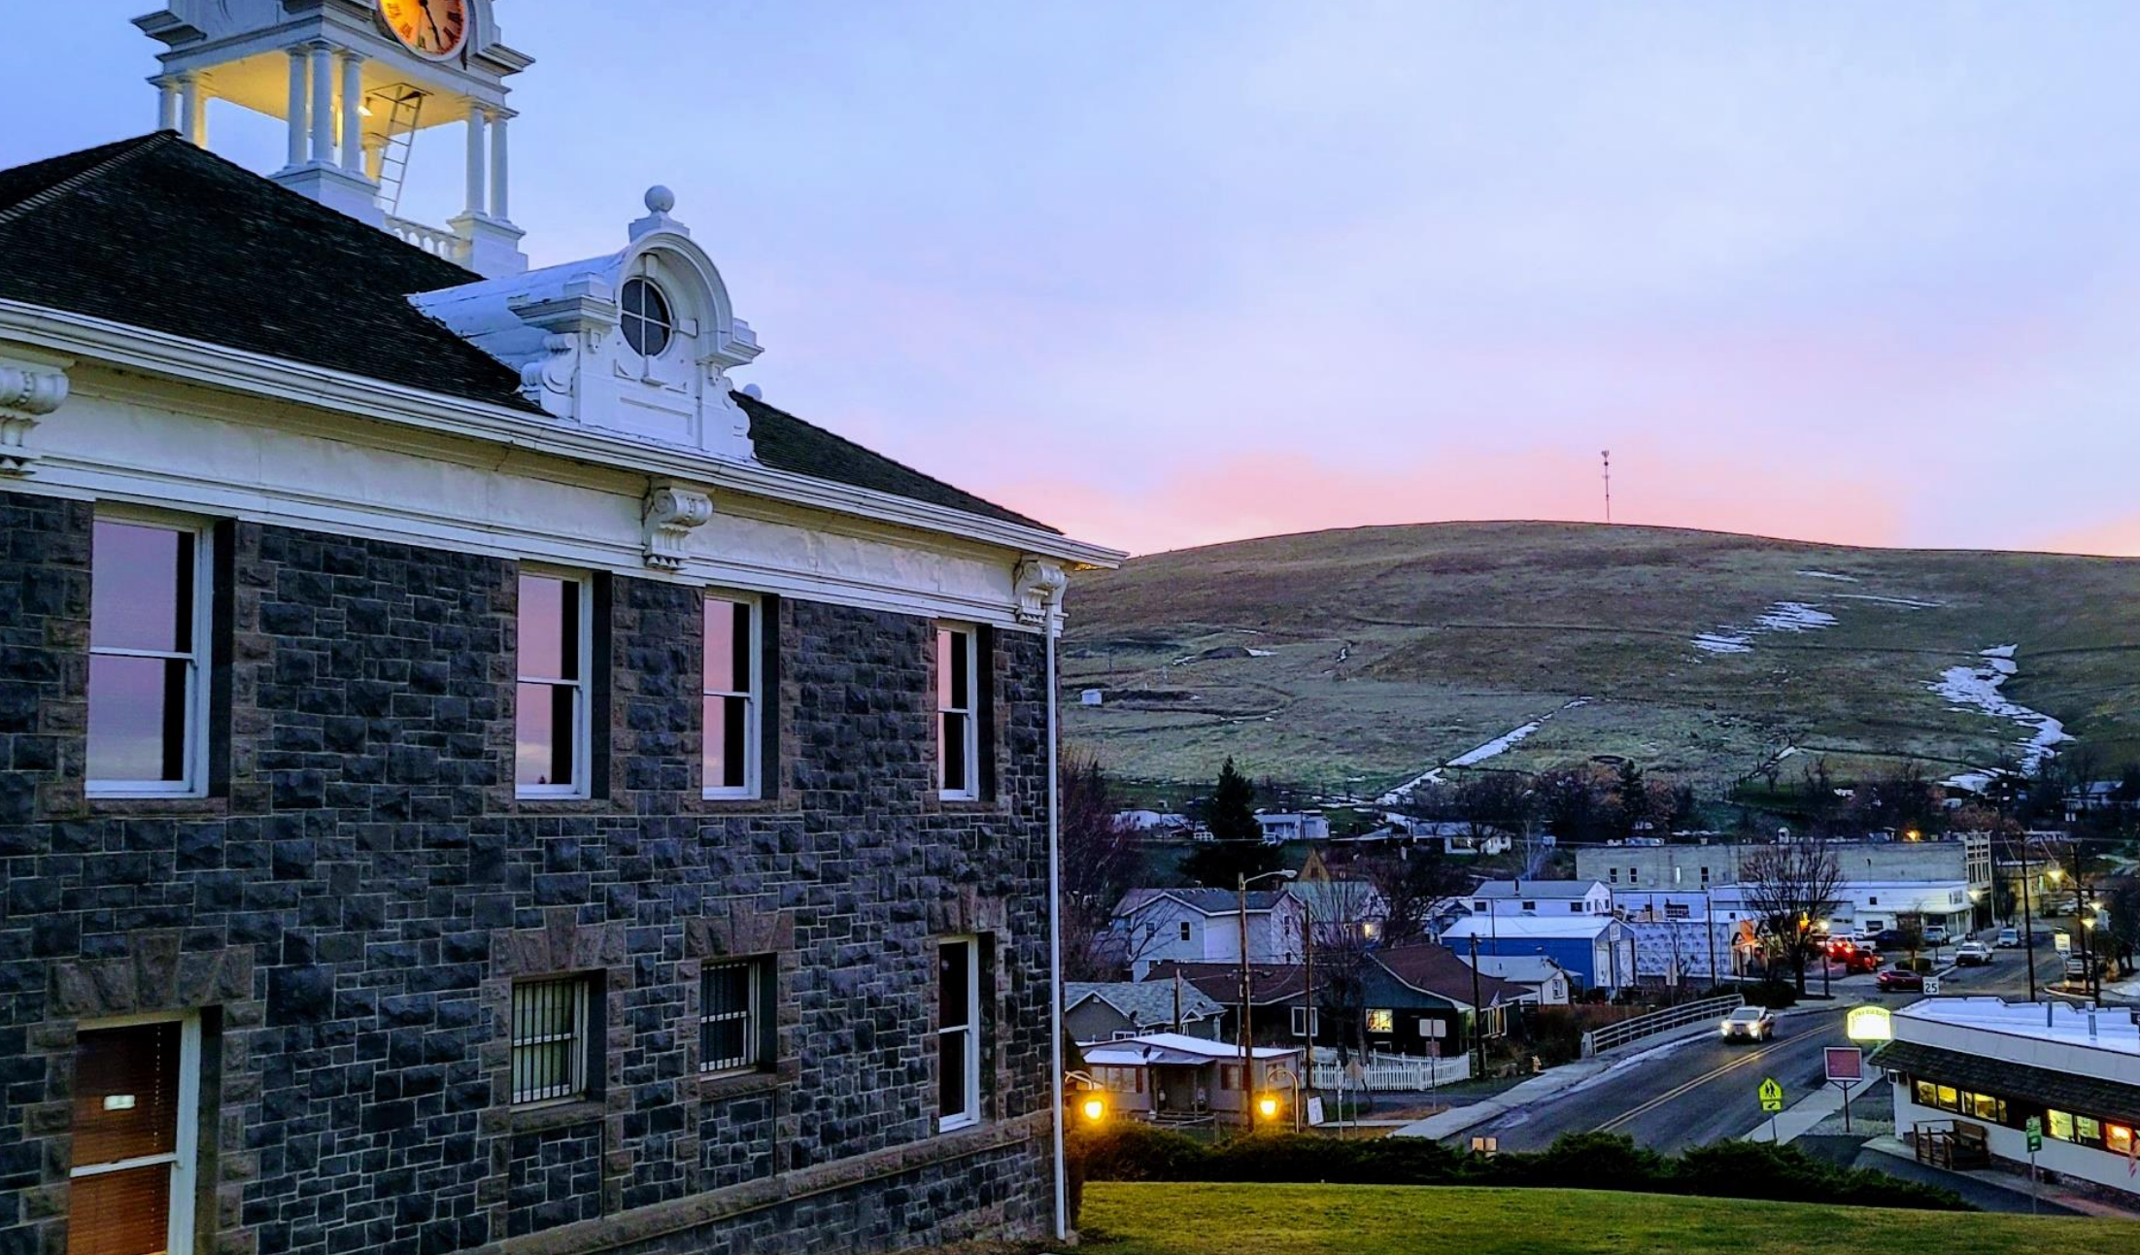
The Loop
Morrow County Public Transit
Fixed Route Soft Launch
2024

Slide 2
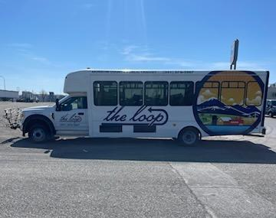
Loop drivers have been running test routes since we hired our first full time drivers in January of 2024.

Slide 3
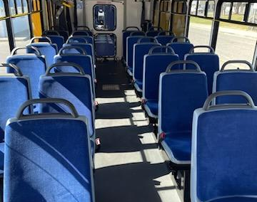
Since that time, we have gotten our busses wrapped with the loop logo and information and have had them road testing the routes.

Slide 4










We have engaged in numerous conversations with our key stakeholders through out the region, Morrow County and the individual communities we are able to serve.

Slide 5
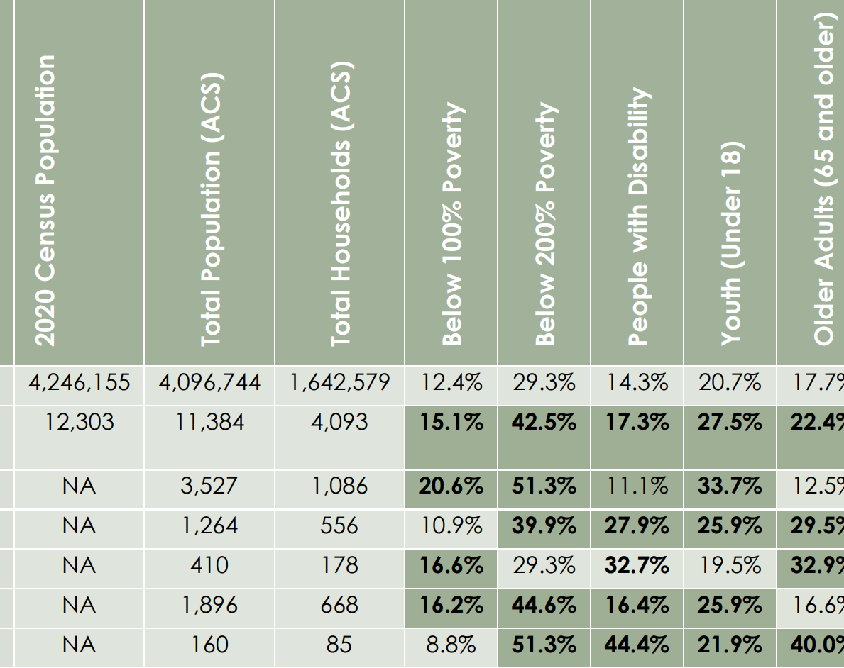
The approval for these two lines was based on studies conducted and completed before Covid 19 changed the face of transportation in general and Morrow County as a whole.

Slide 6
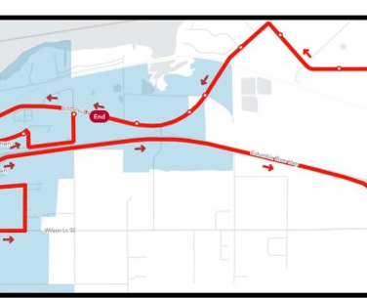
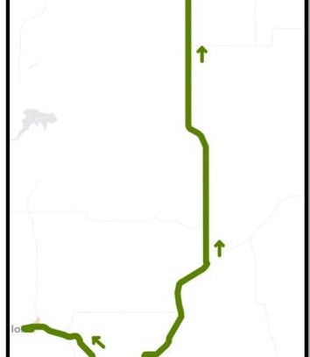
We have grants to serve 2 lines. Heppner to Boardman, "The Connector," and Boardman/ POM, "The Circular."

Slide 7
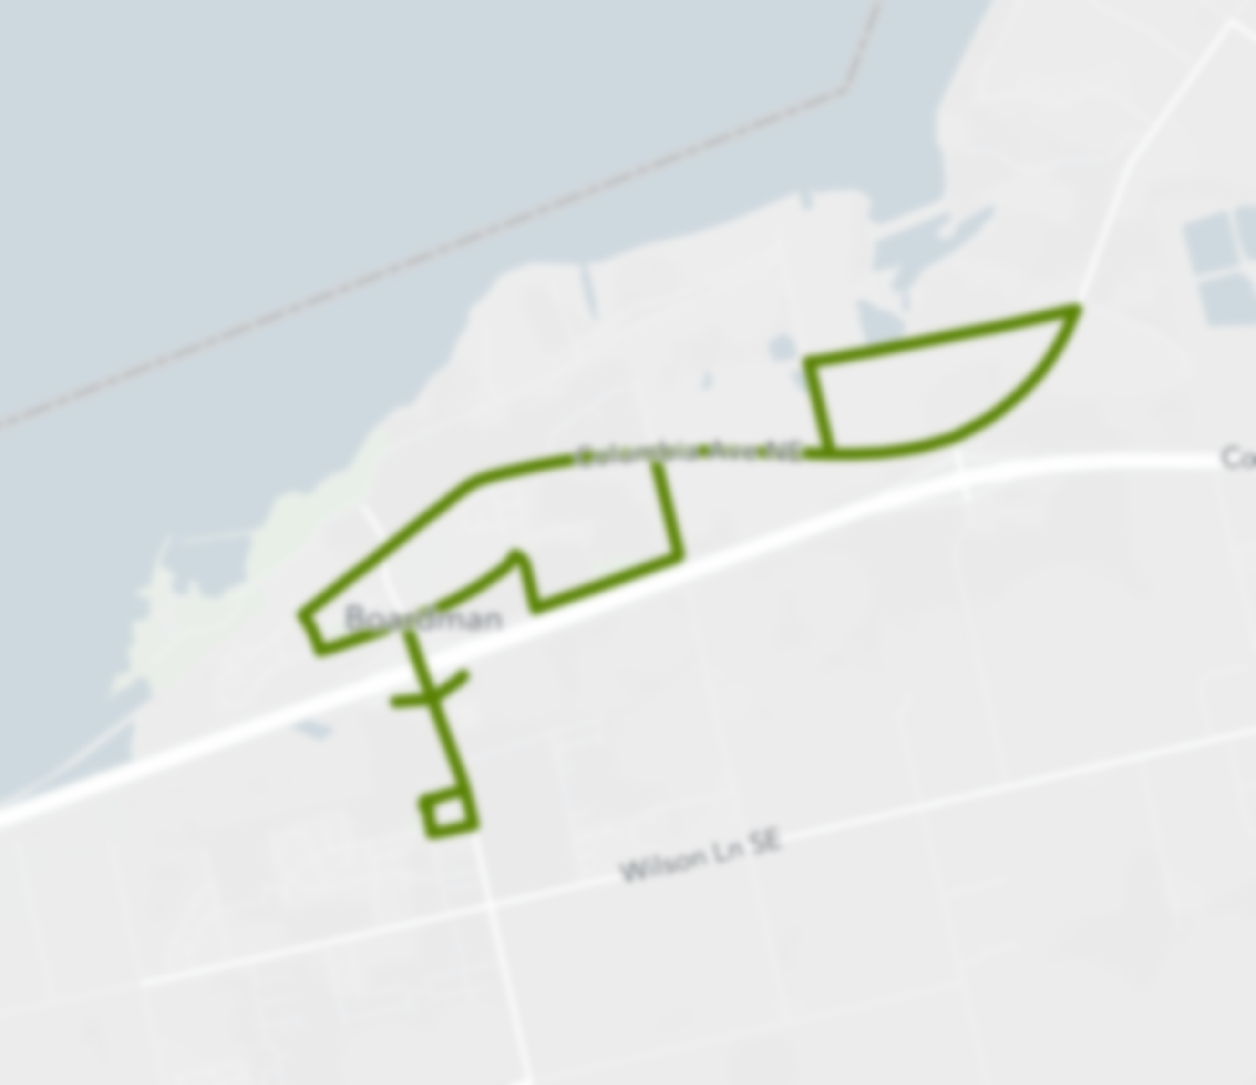
Upon meeting with our community partners we have had to make some significant changes to what was drawn up before we took the reins in order to accommodate community growth.

Slide 8
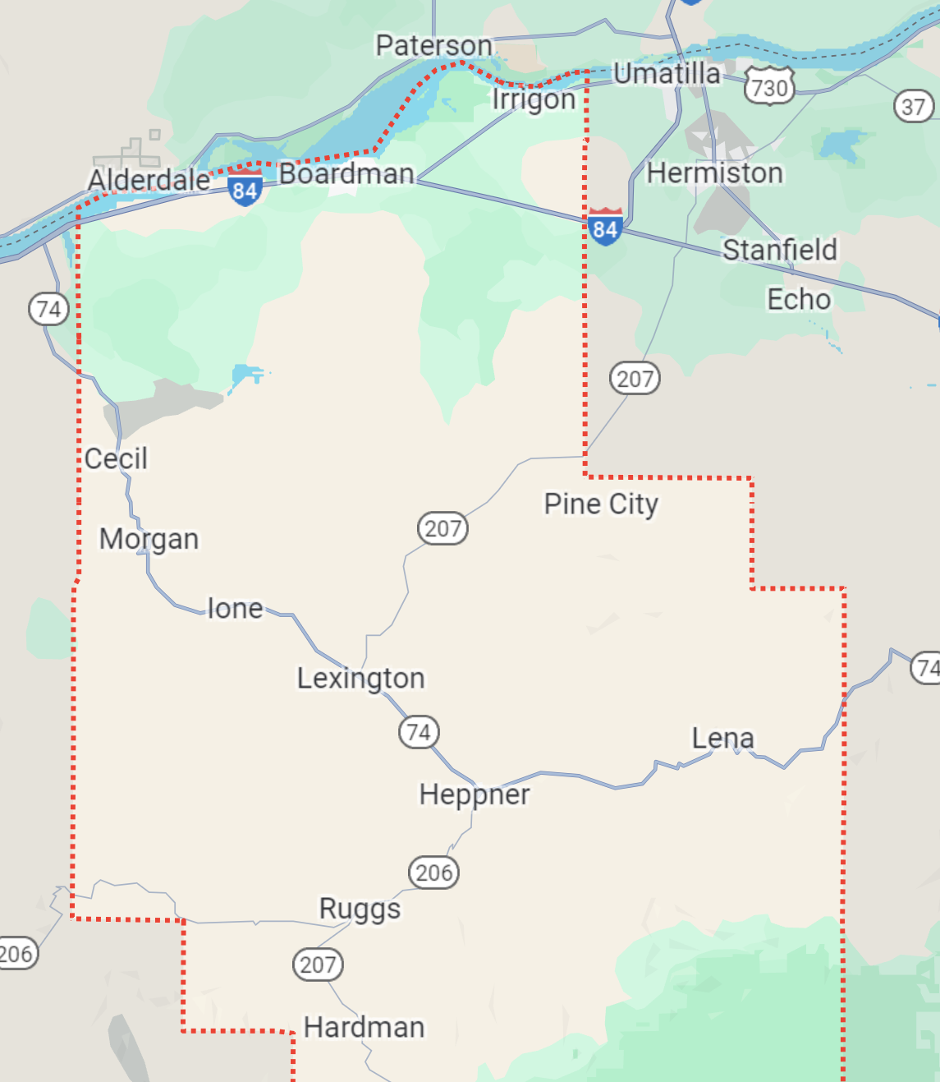
Our current routes are designed around the significant growth that has taken place in the community of Boardman, the POM employers and the services that exist in South Morrow County particularly Heppner.

Slide 9
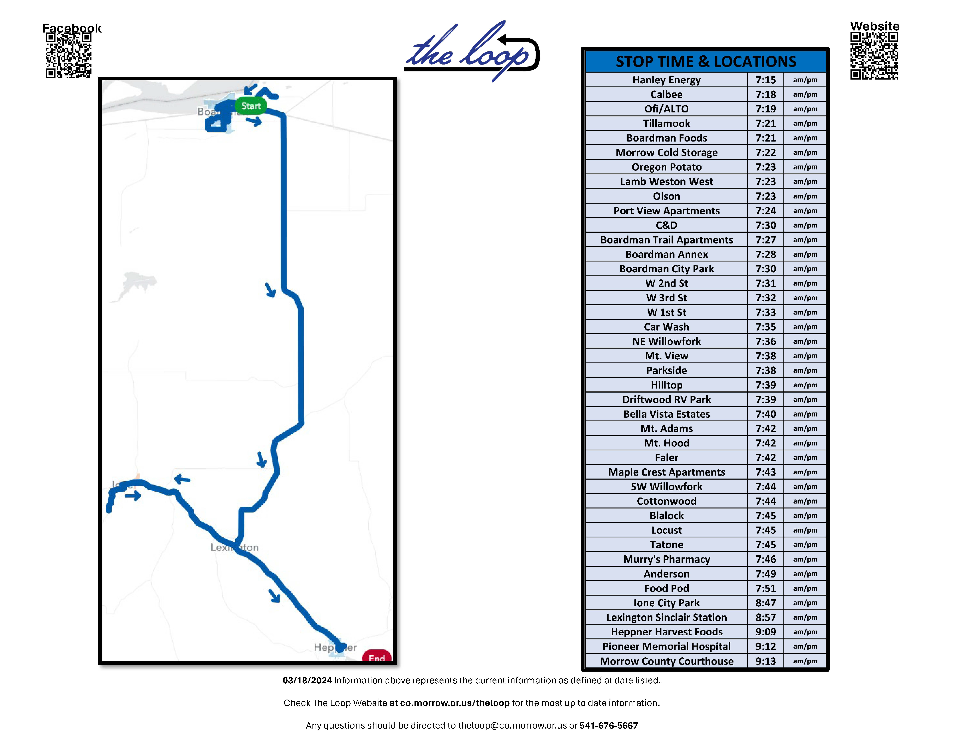

Slide 10
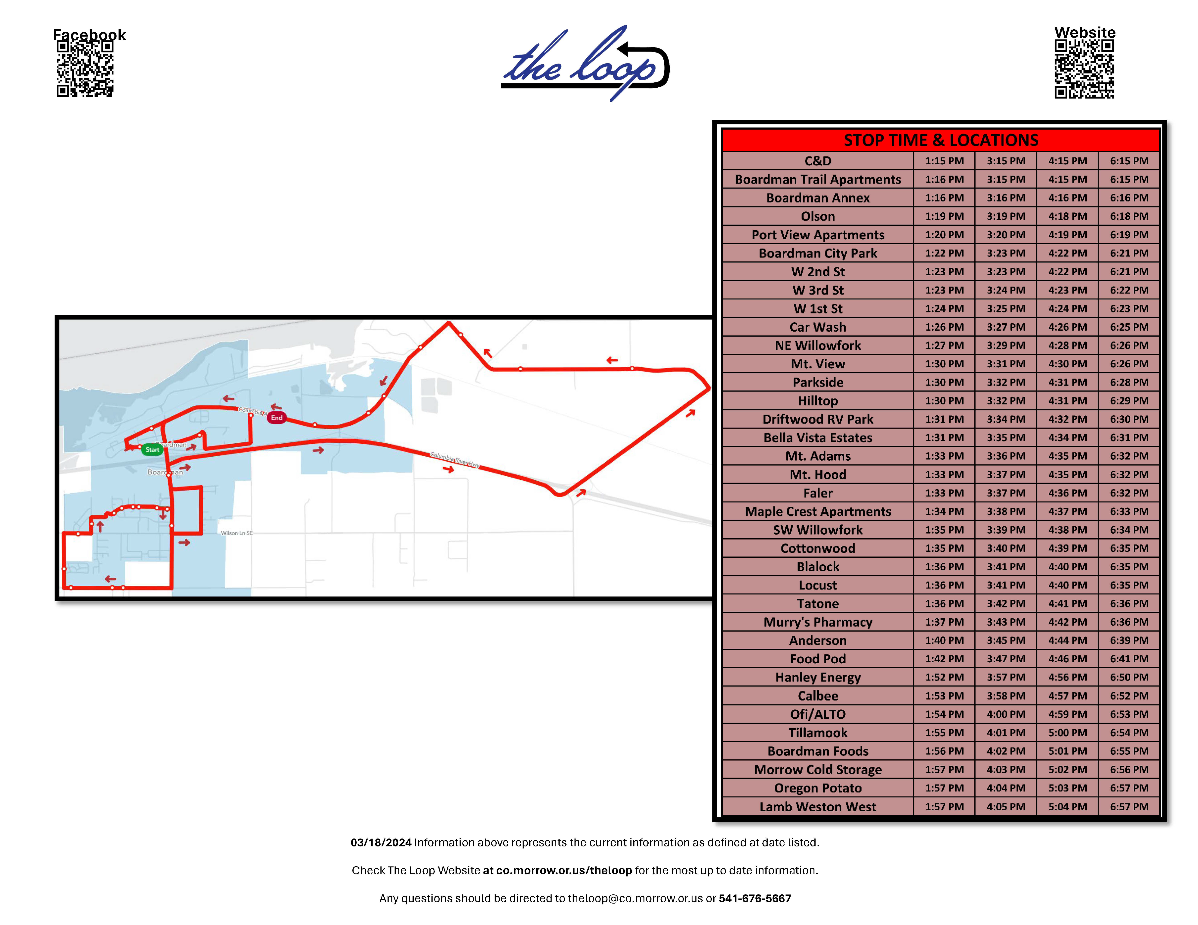

Slide 11
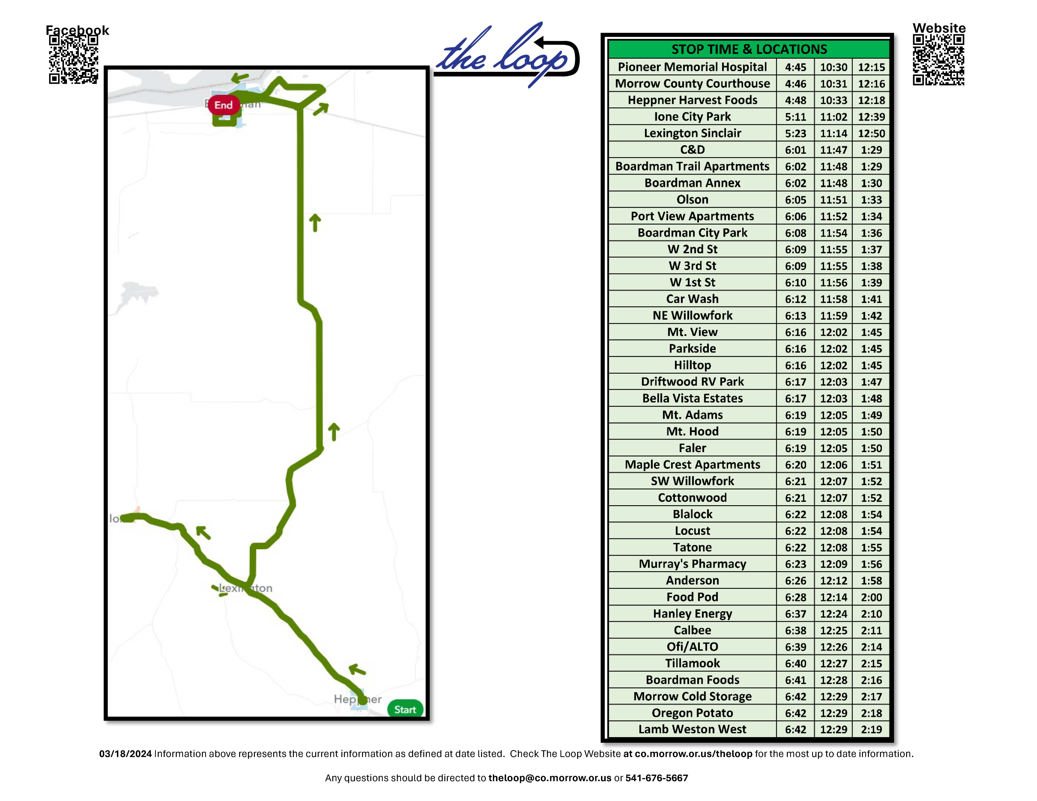

Slide 12
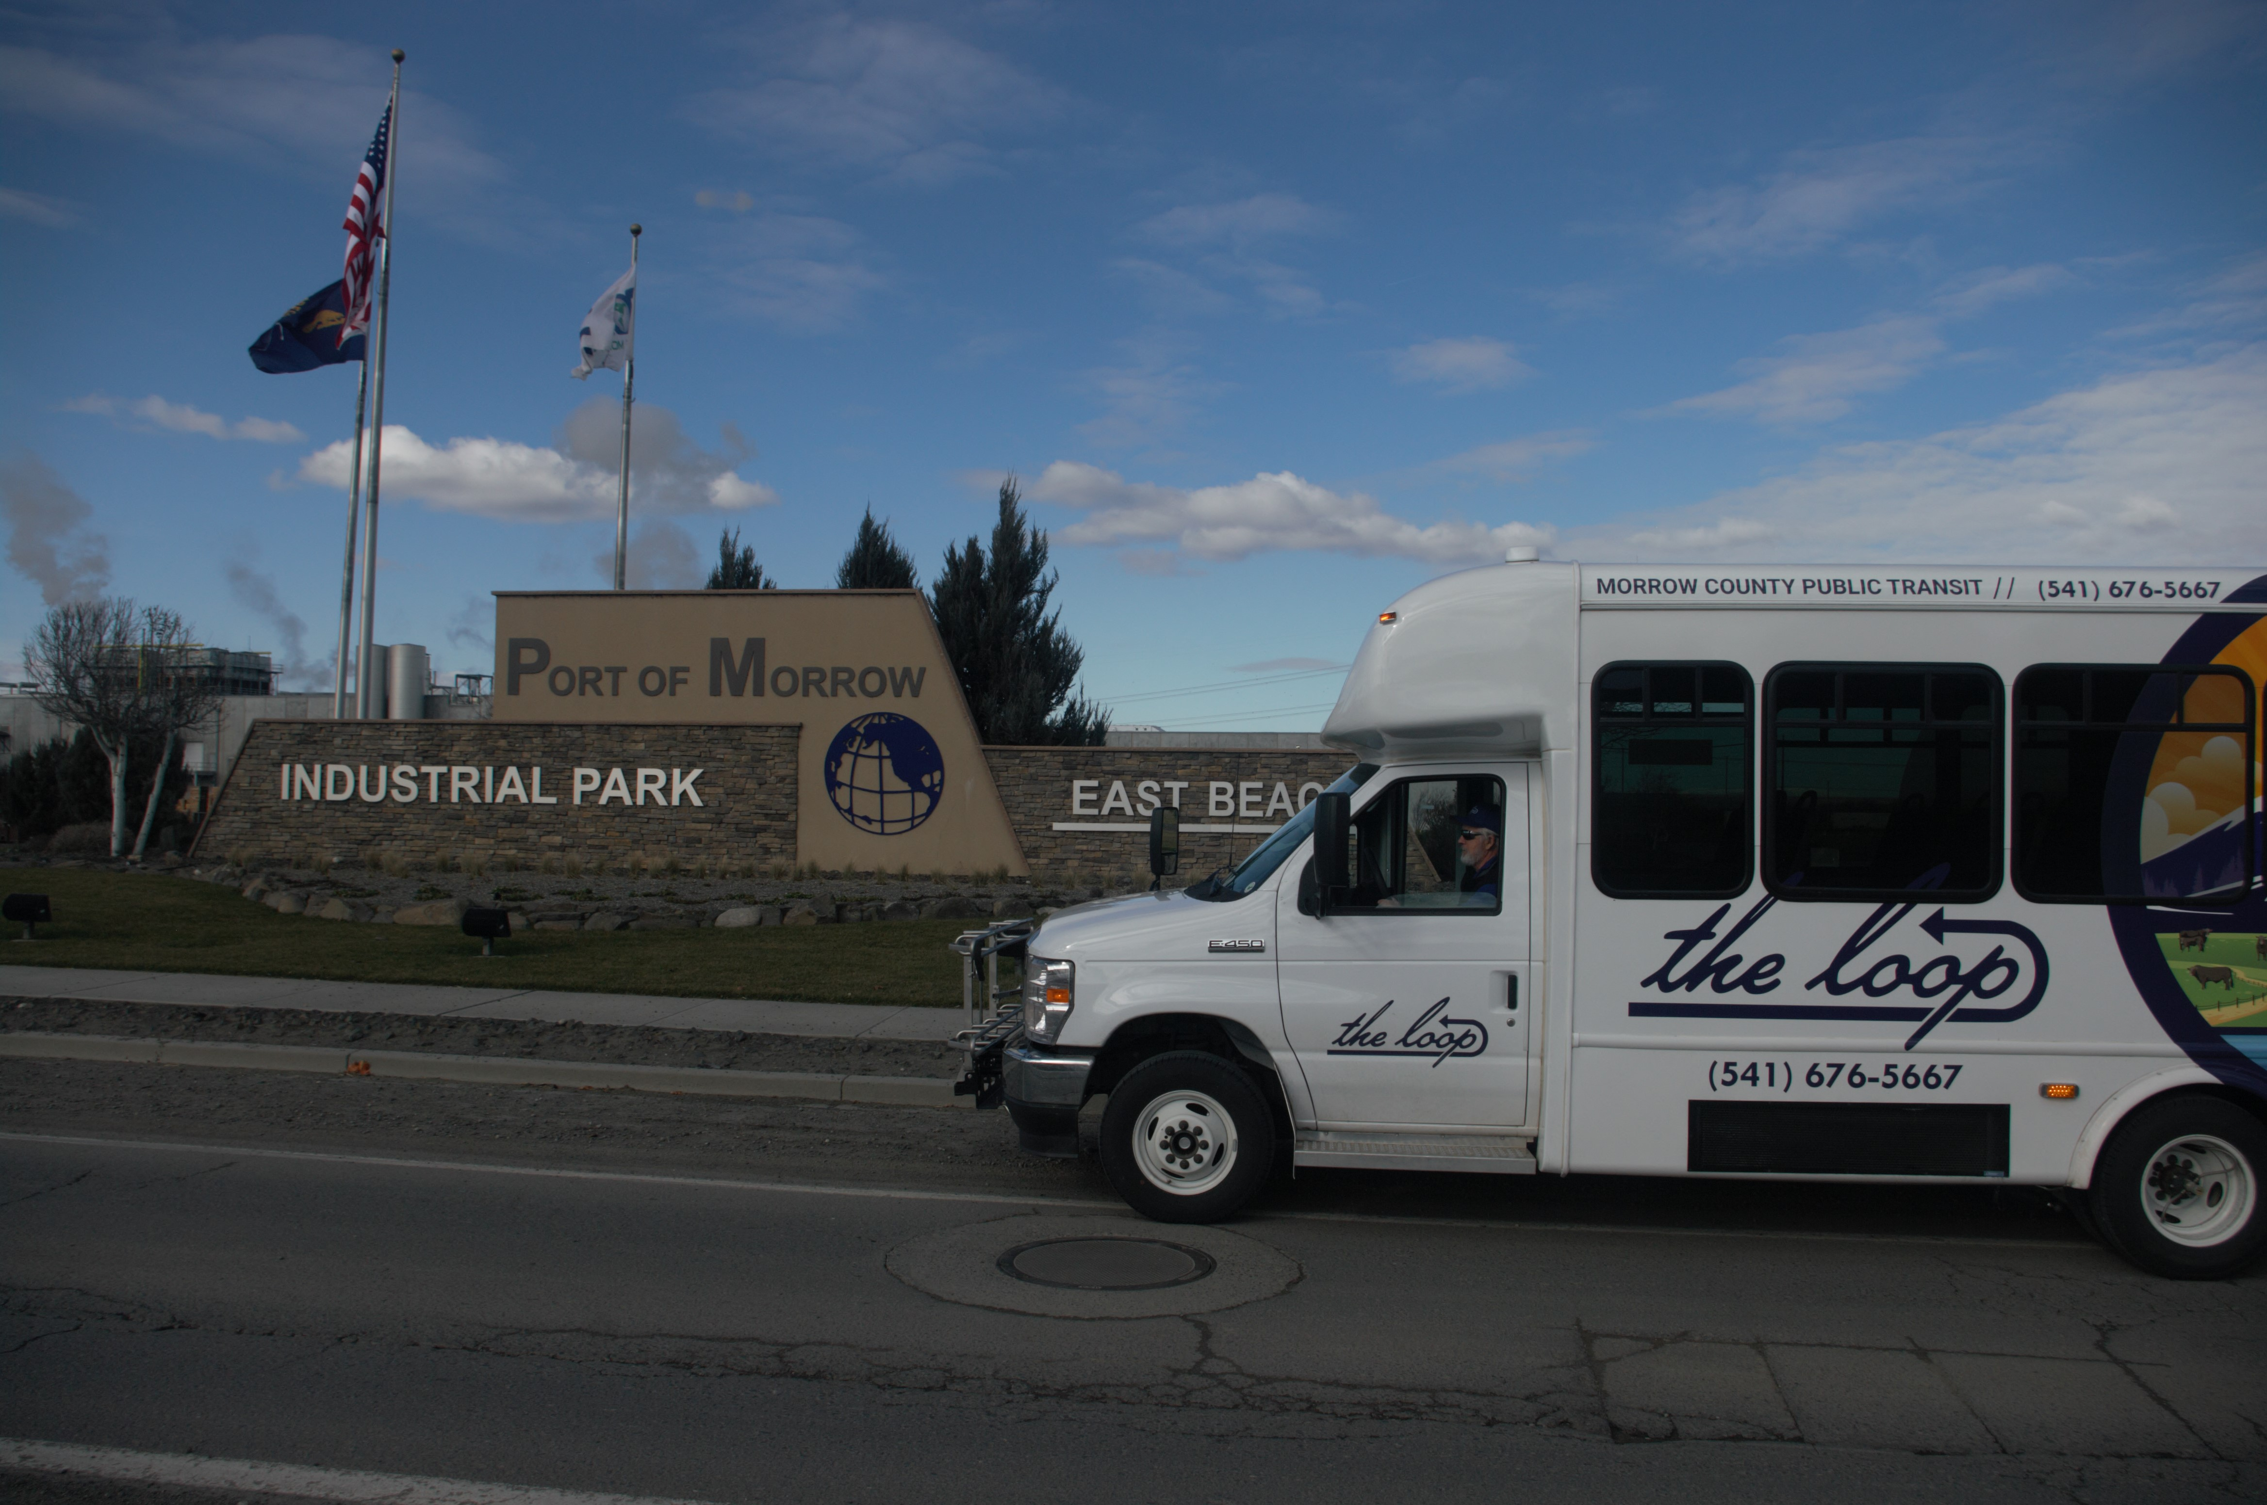
The current routes are designed to get south county residents into Boardman before the 7:00 am shift at the port area employers.
It also takes the North end residents South in a timely manner for Circuit Court proceedings. Before returning at 10:30 and 12:15 respectively.

Slide 13
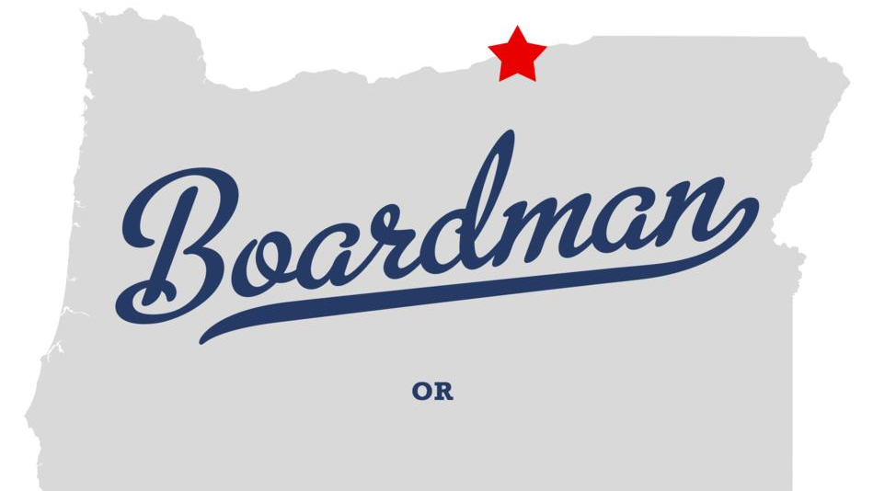
All of the routes between Boardman and Heppner include stops in both Lexington and Ione, and complete a circuit of Boardman. Including those, we have a total of 9 trips around boardman throughout the day.
This Photo by Unknown author is licensed under CC BY-NC.

Slide 14
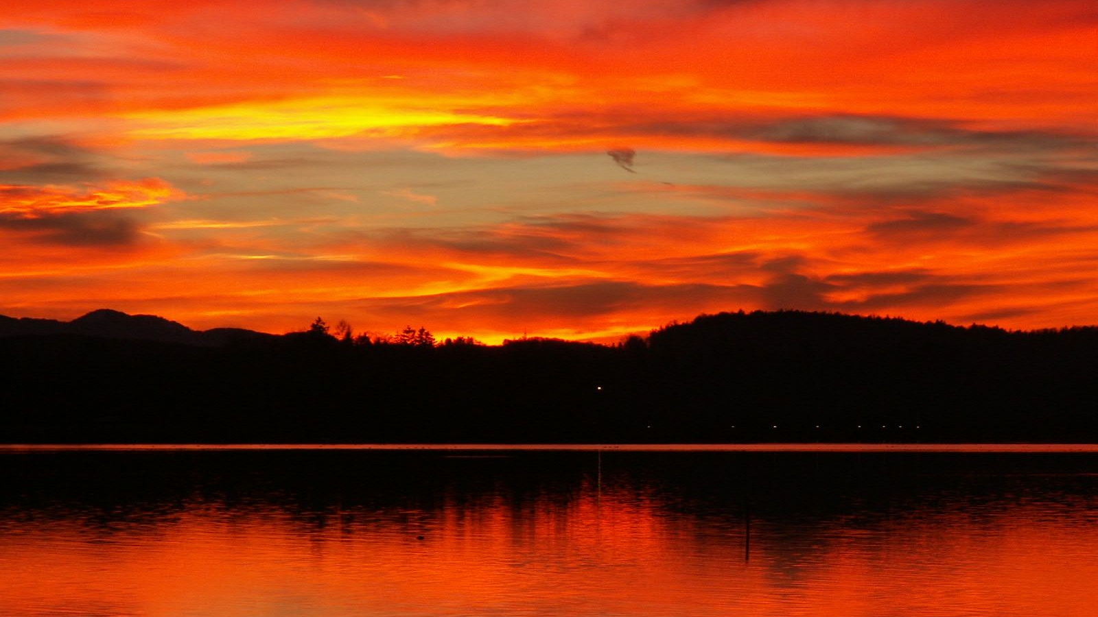
Starting at 7:15 pm our routes are designed to start again at the far end of the Port and make one final lap around Boardman before returning anyone who rode in on the earlier trips, to get them back to South County.
This Photo by Unknown author is licensed under CC BY-SA.

Slide 15

While we recognize that there are significant improvements to be made to the timing of these routes and their spacing, We also understand that there is always the need to evolve in the transit world and the only way to make sure that the changes we are making are valid, is to have drivers behind the wheel and passengers in the seat from which to gain the data.
This Photo by Unknown author is licensed under CC BY-NC.

Slide 16
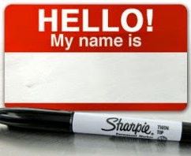
Now that we have something to advertise, we are looking for the community's assistance in getting the word out. As part of that we have launched a campaign to help us name our routes. Information can be found on the loop web page. But name suggestions should be sent to theloop@co.morrow.or.us Subject: Name
This Photo by Unknown author is licensed under CC BY-SA-NC.

Slide 17

We are also pushing hard to develop a list of persons to include future press release information to.
Anyone wanting to be added to our future mailings should send the request to. theloop@co.morrow.or.us
Subject: Add Me

Slide 18

Yesterday we were able to release the information to county employees via the county email server so that they were able to have the first look at the information. This serves us in two ways; 1. It gets more eyes on the information to help us identify problems in the formatting. 2, It gets the information into the hands of the people who are most likely to be getting questions from their friends and family.
Nobody likes to be the last to know that something is happening at work.

Slide 19
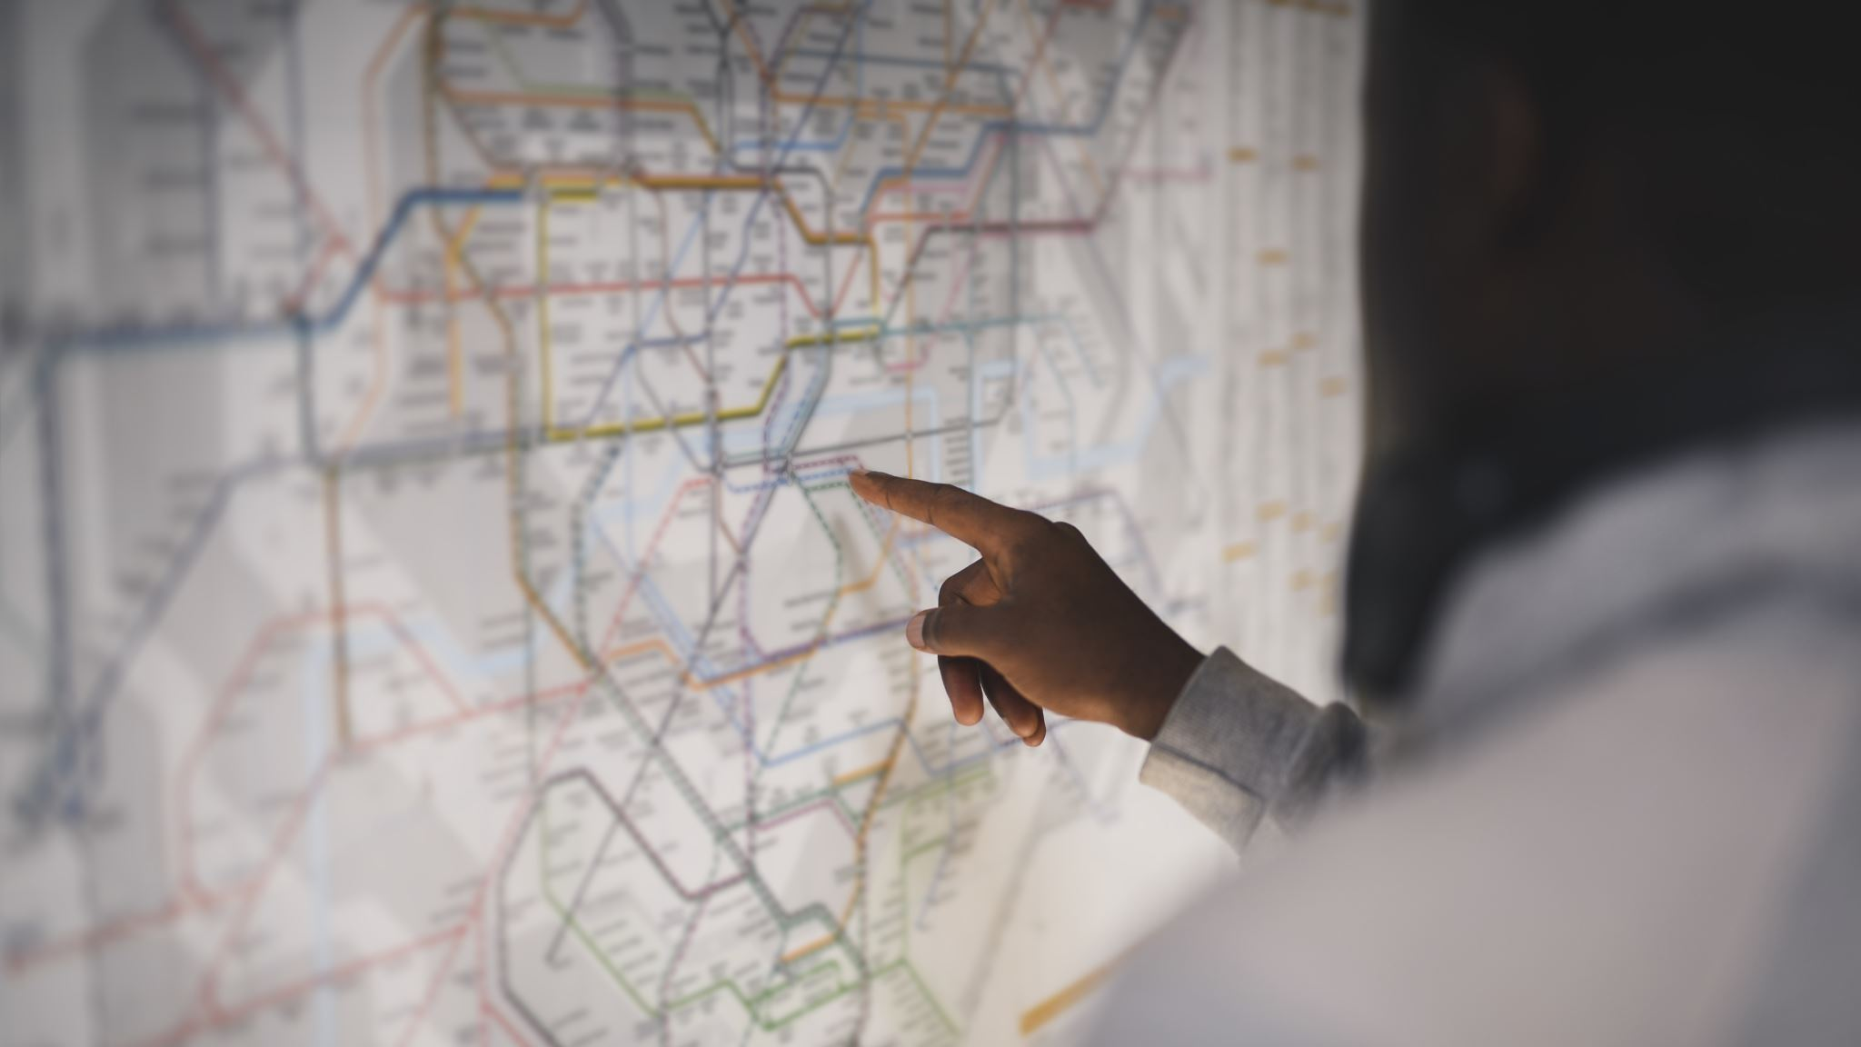
The route information that is available on the website, was sent out county employees yesterday, and is being presented here today is being sent out as we speak to the list of persons and organizations that we have been able to compile so far.

Slide 20

The last and largest part of our soft launch is set to occur on April 1, 2024.
We would like to formally invite the commissioners, the general public and any media outlets to join us at one of two ribbon cutting ceremonies we are hosting in Heppner and Boardman on that day.

